Slide 1
Senior Project
Final Presentation
Summer 2016
VIP 3.0 Team Member(s): Michael Martinez, Vladan Lalovic, Johnatan Jensen, Daniel Lopez Product Owner(s): Masoud Sadjadi, Mohsen Taheri, Maral Kargarmoakhar
School of Computing and Information Sciences Florida International University

Slide 2
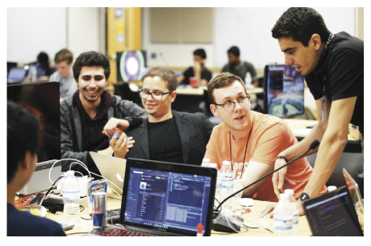

Project definition
Whole Project Definition:
VIP is a platform that allows YOU to connect and work with other motivated individuals to turn great ideas into reality!
This platform will grant you visibility and showcase your idea to the WORLD!
Why should I register to VIP?
Notes:
Introduce the problem that the whole project tackles and stay focused on the parts that you have been working. Indicate if there is an existing previous system, enumerate its problems/limitations, etc.

Slide 3
Project definition
Whole Project:
VIP 1.0 – Pre-Alpha Stage
VIP 2.0 – Alpha Stage (Semi-Functional Static Website & Mobile Judge)
VIP 3.0 – Open-Beta Stage (Dynamic Functional Website)
Notes:
Introduce the problem that the whole project tackles and stay focused on the parts that you have been working. Indicate if there is an existing previous system, enumerate its problems/limitations, etc.

Slide 4
User Stories
UserStory #1065 – Create an Admin Panel
UserStory #977 – Review Project Proposals
UserStory #978 – Review Student Applications
UserStory #1031 – View Recent History Feature
UserStory #1117 – Add Members via Project Proposal Page
Notes:
Messaging System for Users – Website is all about projects and users being able to join them. Messaging system is critical because communication in projects is a major factor which contributes to the success of the project – users must be able to communicate effectively. The messaging system allows users to communicate with each other simply by browsing the teams page and clicking ONE BUTTON to message as many users at once as you want – you can message 1 user in your project, 5, or all of them. You don’t need to know the users email, the messaging system gets that information for you automatically as soon as you click on the users name – this provides a good user experience
Filters for the Projects/Teams page – important because we hope to have many projects from different – semesters, archive, active/inactive, full/available, ect. And we want a smooth user experience when searching for a project.
3. Creating and Maintaining the Development Server – was difficult due to port issues, only having 1 ip address. Explain how this is very important for us to have because many people are using the website and we have to be 100% sure that all recent changes are working before pushing to the live server at vip.fiu.edu.
4. Fixing Issues with Existing Features & Crashing – look at some of the more significant bugs that caused a feature to totally fail or become unusable. Show before/after picture of the situation to illustrate how important fixing bugs really is – especially big bugs which severely impact the performance/functionality of the website, or major features of the website.

Slide 5
User Story #1065: Create an Admin Panel
My most Important user story!
Problem: What happens if a Co-PI/PI wishes to change records without having the rights to database?
Solution: Give Co-PI/PI the ability to do anything via Admin Panel Page.
Most Important Tasks:
Created User-Friendly Admin Layout!
Powerful and efficient Search feature with many advanced filter options!
Ability to confirm, reject, message and delete accounts.
Ability to change a User’s account type and
User’s project.
Notes:
4. Requirements:
4.1. User stories implemented (one or more slides).
4.2. UML use cases and the use case diagram for the implemented use cases (one or more slides).
4.3. UML sequence diagrams for the implemented use cases.

Slide 6
Search Users Feature

Slide 7
Confirm/Reject User Account

Slide 8
Delete Account

Slide 9
Change User’s Type

Slide 10
Change User’s Project

Slide 11
User Story #977: Create Review Project Proposal Page
Problem: We cannot just allow users to create projects. There must be a way to review them before they are shown on Teams page.
Solution: Create a Review Project Proposal page that allows Co-PI/PI to review them.
Most Important Tasks:
Create Review Page Layout
Show all Pending Projects
Accept/Reject Button
Notes:
4. Requirements:
4.1. User stories implemented (one or more slides).
4.2. UML use cases and the use case diagram for the implemented use cases (one or more slides).
4.3. UML sequence diagrams for the implemented use cases.

Slide 12
Accepting/Rejecting a Project

Slide 13
User Story #978: Create Review Student Applications Page
Problem: We cannot just allow users to join whatever project they want. We must be able to review them first.
Solution: Create a Review Student Applications page that allows Co-PI/PI & Faculty to review them.
Most Important Tasks:
Create Review Page Layout
Show all Pending Applications
Accept/Reject Button
Notes:
4. Requirements:
4.1. User stories implemented (one or more slides).
4.2. UML use cases and the use case diagram for the implemented use cases (one or more slides).
4.3. UML sequence diagrams for the implemented use cases.

Slide 14
Accepting/Rejecting an Application

Slide 15
User Story #1031: View Recent History Feature
Problem: How to undo changes for applications and proposals without having to contact Database Master?
Solution: Create a panel that shows the history of logs for applications and proposals with ability to undo them.
Most Important Tasks:
Create a Log Schema to store Logs
Undo Button for confirm or reject actions.
Functionality for all Review Pages (Proposal & Application).
Delete/Clear Logs button
Notes:
4. Requirements:
4.1. User stories implemented (one or more slides).
4.2. UML use cases and the use case diagram for the implemented use cases (one or more slides).
4.3. UML sequence diagrams for the implemented use cases.

Slide 16
Log Created

Slide 17
Undo Log

Slide 18
Delete Log

Slide 19
User Story #1117: Add Members via Project Proposal Page
Problem: How do I add members to a project who have not created an account? I would like users to see these users and click on their account once they have made an account.
Solution: Add Mentors, Faculties, and Students to be added to Project when being created or edited. They will be linked once the user makes an account.
Most Important Tasks:
Add Mentor, Faculty, and Student fields to Proposal Page
Show these users on Teams page
Once account created, they are linked!
Notes:
4. Requirements:
4.1. User stories implemented (one or more slides).
4.2. UML use cases and the use case diagram for the implemented use cases (one or more slides).
4.3. UML sequence diagrams for the implemented use cases.

Slide 20
Add Members to Project

Slide 21
Edit Members

Slide 22
USE CASE DIAGRAM

Slide 23
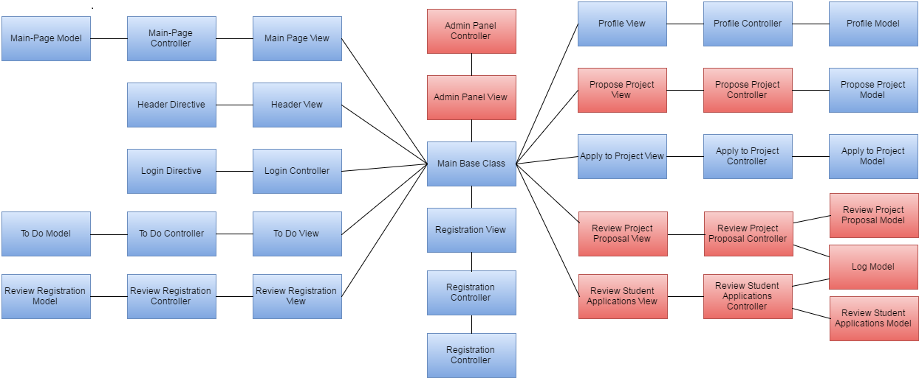
MINIMAL CLASS DIAGRAM

Slide 24
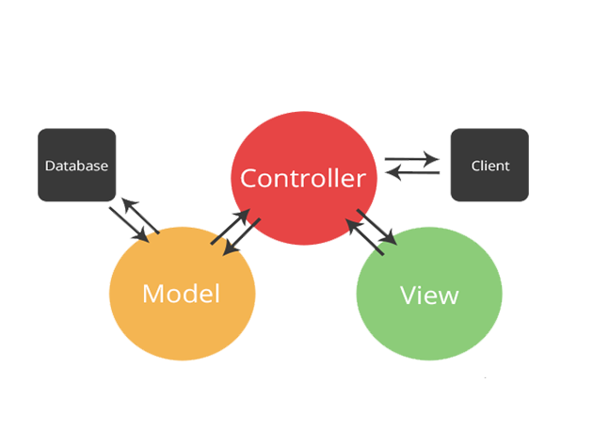

SYSTEM DESIGN: ARCHITECTURE
SOFTWARE
MVC
HARDWARE
CLIENT-SERVER

Slide 25
Test Case
Here I present a test case, one of many that shows that VIP development team prides itself in software testing.
Test Case 1 Sunny Day (PASS)
Purpose
To test that change UserType works
Precondition
User account selected on drop-down
Input
Change usertype from student to Co-PI/PI
Expected Result
Usertype changed to Co-PI/PI
Actual Result
As Expected Result.
Test Case 2 Rainy Day (FAIL)
Purpose
To test that reject unconfirmed user doesn’t delete account
Precondition
Select User account on drop-down
Input
Click on Reject Button
Expected Result
Account rejected but account not deleted.
Actual Result
Account gets deleted.

Slide 26
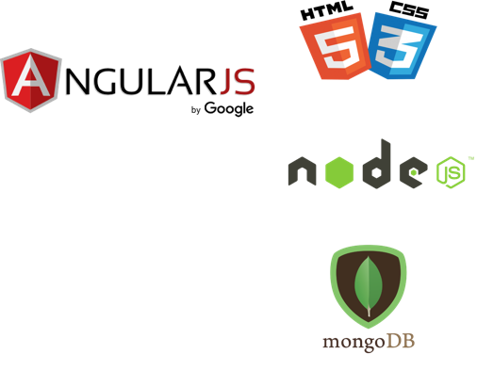

THANKS!
In short, My contributions to VIP 3.0 have given more administrative abilities and freedom for Co-PI/PI and Staff/Faculty users to manage users and projects.
Any questions?
CONTACT | mmart196@FIU.EDU

